Slide 1
Basic Light Field
ShanghaiTech CS 276
Fall 2021
Lecture 1

Slide 2
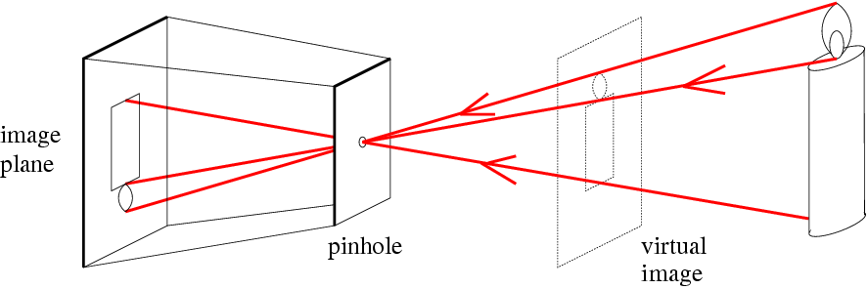
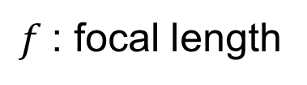
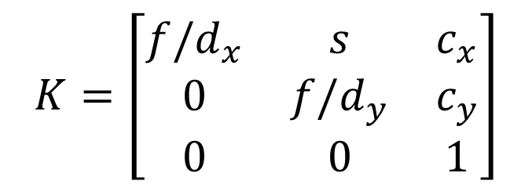
Review: Pinhole Camera
$$K=\left[\begin{matrix}f/d_{x} & s & c_{x} \\ 0 & f/d_{y} & c_{y} \\ 0 & 0 & 1\end{matrix}\right]$$
A Camera captures a set of rays
A pinhole camera captures a set of rays passing through a common 3D point
$f$: focal length
(CoP)

Slide 3
Camera Array
Capture a set of images
Capture a set of rays
Any differences between a camera and a camera array?
A 3D point can be seen multiple times by a camera array!
MIT Camera Array
Stanford Camera Array

Slide 4
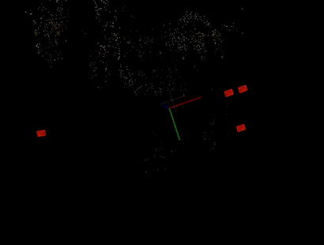
Application: Novel View Synthesis
Explicit geometry(3D Reconstruction)
Structure from motion
Multi-view stereo
No geometry(Image-based Rendering)
Light field
Lumigraph
Implicit geometry (Neural Rendering)
Neural Volumes
Neural radiance field (NeRF)

Slide 5
Basic idea of Light field
Novel view synthesis
Novel view rays
Query from ray database
Interpolate a ray if it does not exist

Slide 6
How to represent a light field?
How to represent a ray in 3D space:
Two points on the line (3D + 3D = 6D)
A point and a direction (Euler angle) (3D + 2D = 5D)
Any better Parameterization?

Slide 7
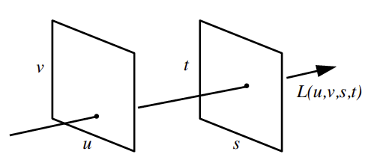
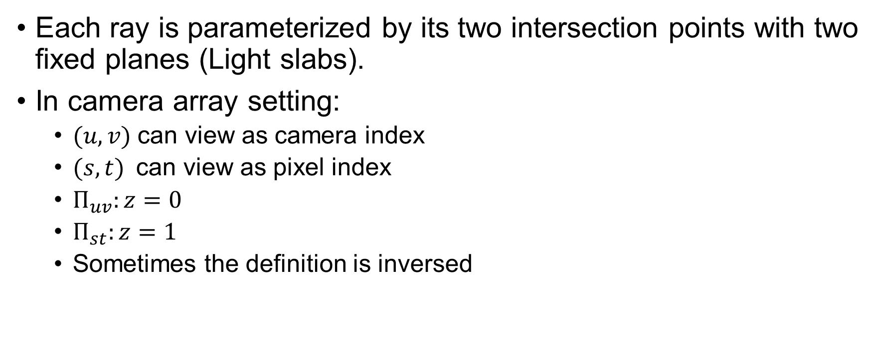
Two Plane Parameterization
Each ray is parameterized by its two intersection points with two fixed planes (Light slabs).
In camera array setting:
$(u, v)$can view as camera index
$(s, t)$can view as pixel index
$Π_{uv}:z=0$
$Π_{st}:z=1$
Sometimes the definition is inversed
Light slab representation
Notes:
最简单的一个Light slab

Slide 8
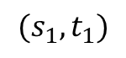
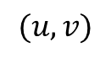
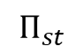
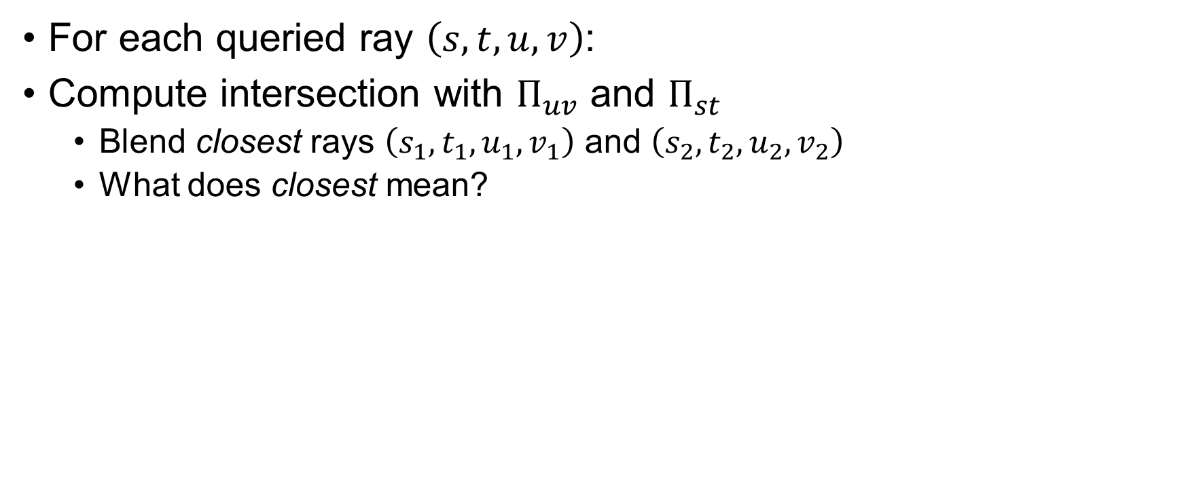
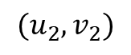
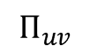
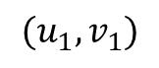
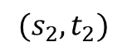
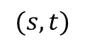
Light Field Rendering
For each queried ray $\left(s,t,u,v\right)$:
Compute intersection with $Π_{uv}$ and $Π_{st}$
Blend closest rays $\left(s_{1},t_{1},u_{1},v_{1}\right)$ and $\left(s_{2},t_{2},u_{2},v_{2}\right)$
What does closest mean?
$$(u_{1},v_{1})$$
$$(u,v)$$
$$(u_{2},v_{2})$$
$$Π_{uv}$$
$$Π_{st}$$
$$(s_{1},t_{1})$$
$$(s,t)$$
$$(s_{2},t_{2})$$

Slide 9
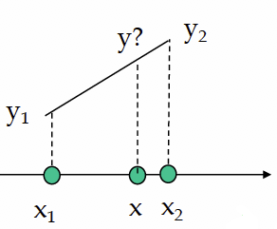
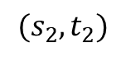
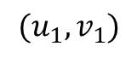
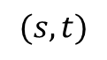
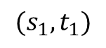
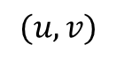
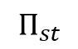
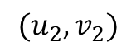
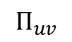
Light Field Rendering
Blending: Linear Interpolation
For 1D Function:
What happens to a higher dimension?
Bilinear, Tri-linear, Quadra-linear
$$(u_{1},v_{1})$$
$$(u,v)$$
$$(u_{2},v_{2})$$
$$Π_{uv}$$
$$Π_{st}$$
$$(s_{1},t_{1})$$
$$(s,t)$$
$$(s_{2},t_{2})$$

Slide 10
Quadra-linear Interpolation
Serious aliasing artifacts
Notes:
分析出现aliasing(走样)的原因：蕴含了所插值位置的光线对应的三维点来自于无穷远的假设 (u, v对应最近的相机， s, t对应方向相同的光线)

Slide 11
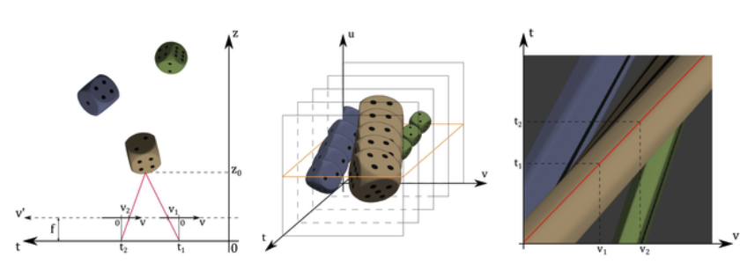
Stack images along t
t1, t2 is camera position
Fix u, yellow plane is epipolar plane image (EPI)
EPI
Notes:
这里大家可以思考如何解出每一根直线的方程

Slide 12
Focal Plane Parameterization
Trace ray to the focal plane
Trace back to the references
Quadra-linear interpolation
Need to do ray-plane intersection
Can we avoid that in camera array?

Slide 13
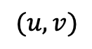
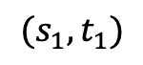
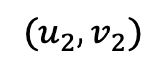
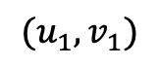
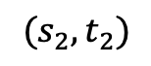
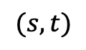
Using camera array property
$$\left(u_{i},v_{i}\right)=\left(u,v\right)+disparity × \left(s_{i}−s,t_{i}−t\right), i=1,2,3,4$$
Focal Plane
$$(u_{1},v_{1})$$
$$(u,v)$$
$$(u_{2},v_{2})$$
Image Plane
Camera Plane
$$(s_{1},t_{1})$$
$$(s,t)$$
$$(s_{2},t_{2})$$
Notes:
根据之前EPI的性质我们可以知道，不同视角下看同一个三维点时，三维点在图像上的投影是随看的位置线性变化的。因此我们可以根据Focal Plane的深度以及相机的参数（包括相机内参和相机的位置）计算出线性变化的比例，即求解出u = k(s-s0) + u0 中的k.同理，如果我们固定disparity，就可以反算出Focal Plane所在的深度，也就是说我们通过遍历disparity就可以实现出简单的重对焦效果。

Slide 14
Results
Quadra-linear
Focus on monitor

Slide 15
Aperture Filtering
Simple and easy to implement
Cause aliasing
Can we blend more than 4 neighboring rays? 8, 16, 32? Or more?
Notes:
Aperture Filtering的意思是，我们放置的虚拟相机是存在光圈的，不是所有相机阵列下的相机都参与到虚拟相机的图像生成中。
在成像平面前画一个透镜，表示经过场景中一个点反射后，只有一部分的光重新汇聚到了虚拟相机。（作图）

Slide 16
Variable Aperture
Notes:
AA‘就是虚拟的Aperture，这里可以看到，当这个aperture越大的时候，我们会cover更多真实相机所采到的光线，并根据Focal Plane进行插值，大家可以想象一下，在这个Aperture越来越大的时候，我们的景深就会更小，因为没有聚焦的位置会更容易模糊。

Slide 17
Changing the shape & size of aperture filter

Slide 18
Small Aperture Size

Slide 19
Large Aperture Size
Notes:
可以看到现在的景深就变小了

Slide 20
Very Large Size Aperture
Looking through the object
Notes:
画一个正常透镜和很大的透镜来解释

Slide 21
Variable Focus
Notes:
其实我们甚至可以不Focus在一个Plane上，我们可以Focus在一个曲面上，不过这样对于每一个虚拟的像素我们都需要计算对应的disparity来进行插值，会带来更大的计算量。而且正如我们之前提到的，我们可以对焦在不同的曲面上

Slide 22
Issues with Light Field
It only captures rays within a region (volume)
It is huge (needs compression)
If implemented using software, a lot of memory fetches
Solution 1: multitexturing
Solution 2: using graphics hardware

Slide 23
Better Reconstruction Method
Assume some geometric proxy
Dynamically reparametrized light field
Notes:
Uv是Focal plane，假设光线从这个plane上的点发出。如果确实存在一个实际的点的话，那么各个相机下会得到很相近的颜色。

Slide 24
Close Focal Surface

Slide 25
Distant Focal Surface

Slide 26
The Lumigraph
Capture: move camera by hand
Camera intrinsics assumed calibrated
Camera pose recovered from markers

Slide 27
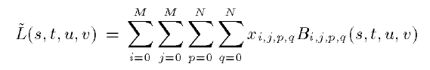
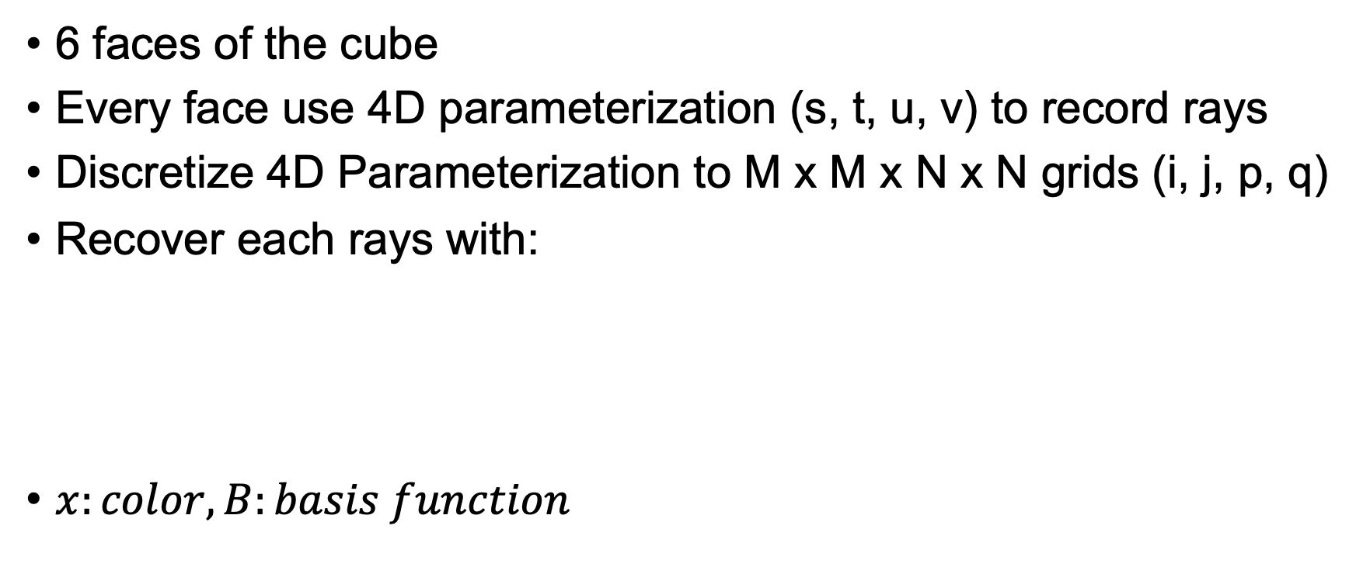
Parameterization of the 3D space
6 faces of the cube
Every face use 4D parameterization (s, t, u, v) to record rays
Discretize 4D Parameterization to M x M x N x N grids (i, j, p, q)
Recover each rays with:
$x:color, B:basis function$
Notes:
Basis function: 每一个grid有一个自己的basis function，表示它对于某一根光线的贡献程度应该是多少。

Slide 28
Lumigraph Postprocessing
Obtain rough geometric model
Chrome keying (blue screen) to extract silhouettes
Octree-based space carving
Resample images to two-plane parameterization
Notes:
这个就是说在获取好了图片以后 lumigraph还做了一些后处理，比如获得了粗糙的几何模型，以及重新采样了图像得到了之前我们提到的六个面的4D表示

Slide 29
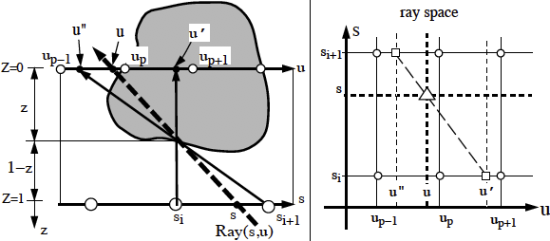
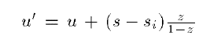
Lumigraph Rendering
Use rough depth information to improve rendering quality
Notes:
这篇文章相比light field比较不同的地方在于：作者描述了如何利用粗糙的几何模型来降低感兴趣的物体的defocus程度。
Note：Ray space下参与插值的光线发生了改变，也就是infocus在物体表面进行插值，和之前的epipolar images很像，这里推导并解释两张图，从离散化表示u，s，然后从虚拟光线ray（s,u）开始推导原本的插值方法和depth corrected后的插值方法的区别。

Slide 30
Lumigraph Rendering
Without using geometry
Using approximate geometry

Slide 31
Assignment 1
Implement a Light Field NeRF:
Novel view synthesis in (u, v, d) coordinates

Slide 32
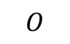
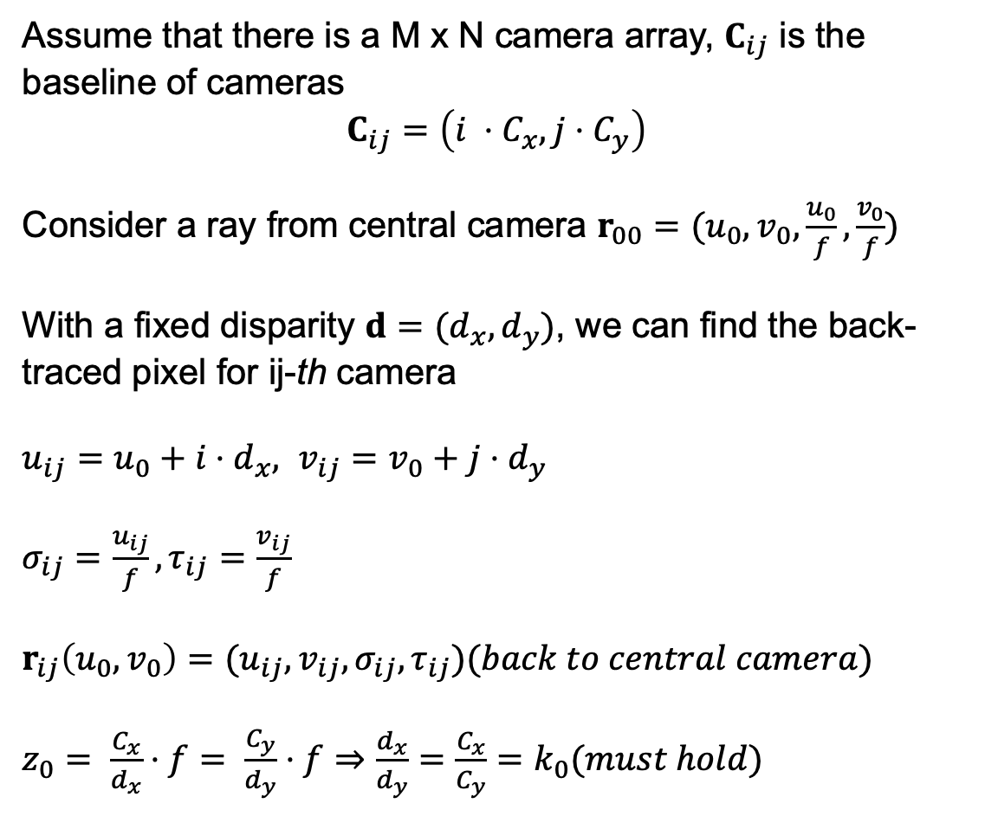

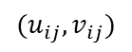
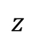
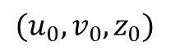
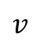
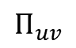
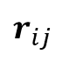
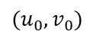
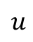
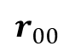
Light Field NeRF
Assume that there is a M x N camera array, $C_{ij}$ is the baseline of cameras
$$C_{ij}=\left({i ⋅C}_{x}, j⋅C_{y}\right)$$
Consider a ray from central camera $r_{00}=(u_{0}, v_{0},\frac{u_{0}}{f},\frac{v_{0}}{f})$
With a fixed disparity $d=(d_{x},d_{y})$, we can find the back-traced pixel for ij-th camera
$u_{ij}=u_{0}+i⋅d_{x}, v_{ij}=v_{0}+j⋅d_{y}$
$σ_{ij}=\frac{u_{ij}}{f},τ_{ij}=\frac{v_{ij}}{f}$
$r_{ij}\left(u_{0},v_{0}\right)=(u_{ij},v_{ij},σ_{ij},τ_{ij})(back to central camera)$
$z_{0}= \frac{C_{x}}{d_{x}}⋅f= \frac{C_{y}}{d_{y}}⋅f⇒\frac{d_{x}}{d_{y}}=\frac{C_{x}}{C_{y}}=k_{0}(must hold)$
$$v$$
$$Π_{uv}$$
$$u$$
$$O$$
Central Camera
$$r_{00}$$
$$z$$
$$(u_{0},v_{0})$$
$$(u_{0},v_{0},z_{0})$$
$r_{ij}$
$$(u_{ij},v_{ij})$$
$$d_{ij}=(i⋅d_{x},j⋅d_{y},0)$$
ij-th Camera

Slide 33
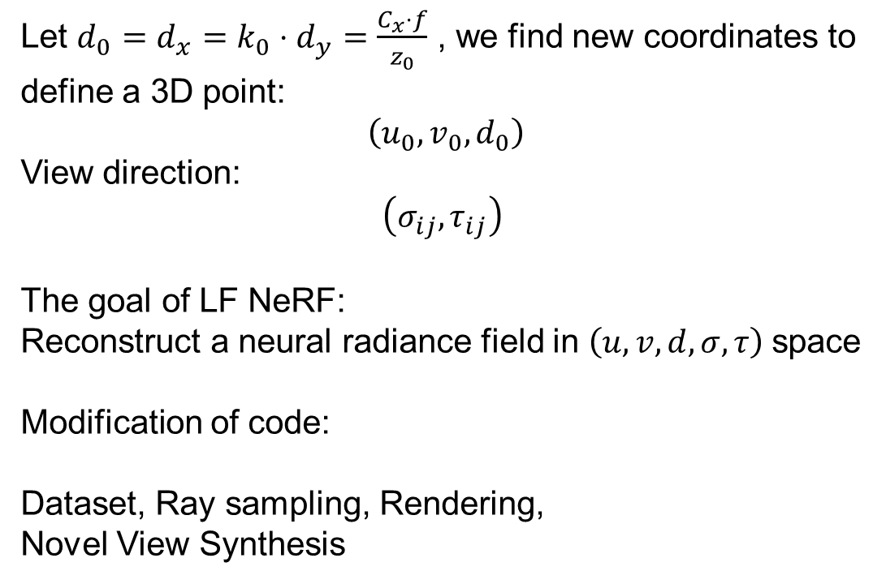
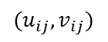
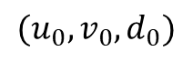
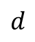
Light Field NeRF
Let $d_{0}=d_{x}=k_{0}⋅d_{y}=\frac{C_{x}⋅f}{z_{0}}$ , we find new coordinates to define a 3D point:
$$\left(u_{0},v_{0},d_{0}\right)$$
View direction:
$$\left(σ_{ij},τ_{ij}\right)$$
The goal of LF NeRF:
Reconstruct a neural radiance field in $\left(u,v,d,σ,τ\right)$space
Modification of code:
Dataset, Ray sampling, Rendering,
Novel View Synthesis
$$v$$
$$Π_{uv}$$
$$u$$
$$O$$
$$d$$
Central Camera
$$r_{00}$$
$$(u_{0},v_{0})$$
$$(u_{0},v_{0},d_{0})$$
$r_{ij}$
$$(u_{ij},v_{ij})$$
$$d_{ij}=(i⋅d_{x},j⋅d_{y},0)$$
ij-th Camera

